Slide 1
Machine Learning (and Artificial Intelligence)
By: Satyen S.

Slide 2

Artificial Intelligence - Will it Rain?
AI - Make a machine think like a human
Q: what would an AI solution to this problem look like?
Notes:
AI must fundamentally is just step by step reasoning

Slide 3

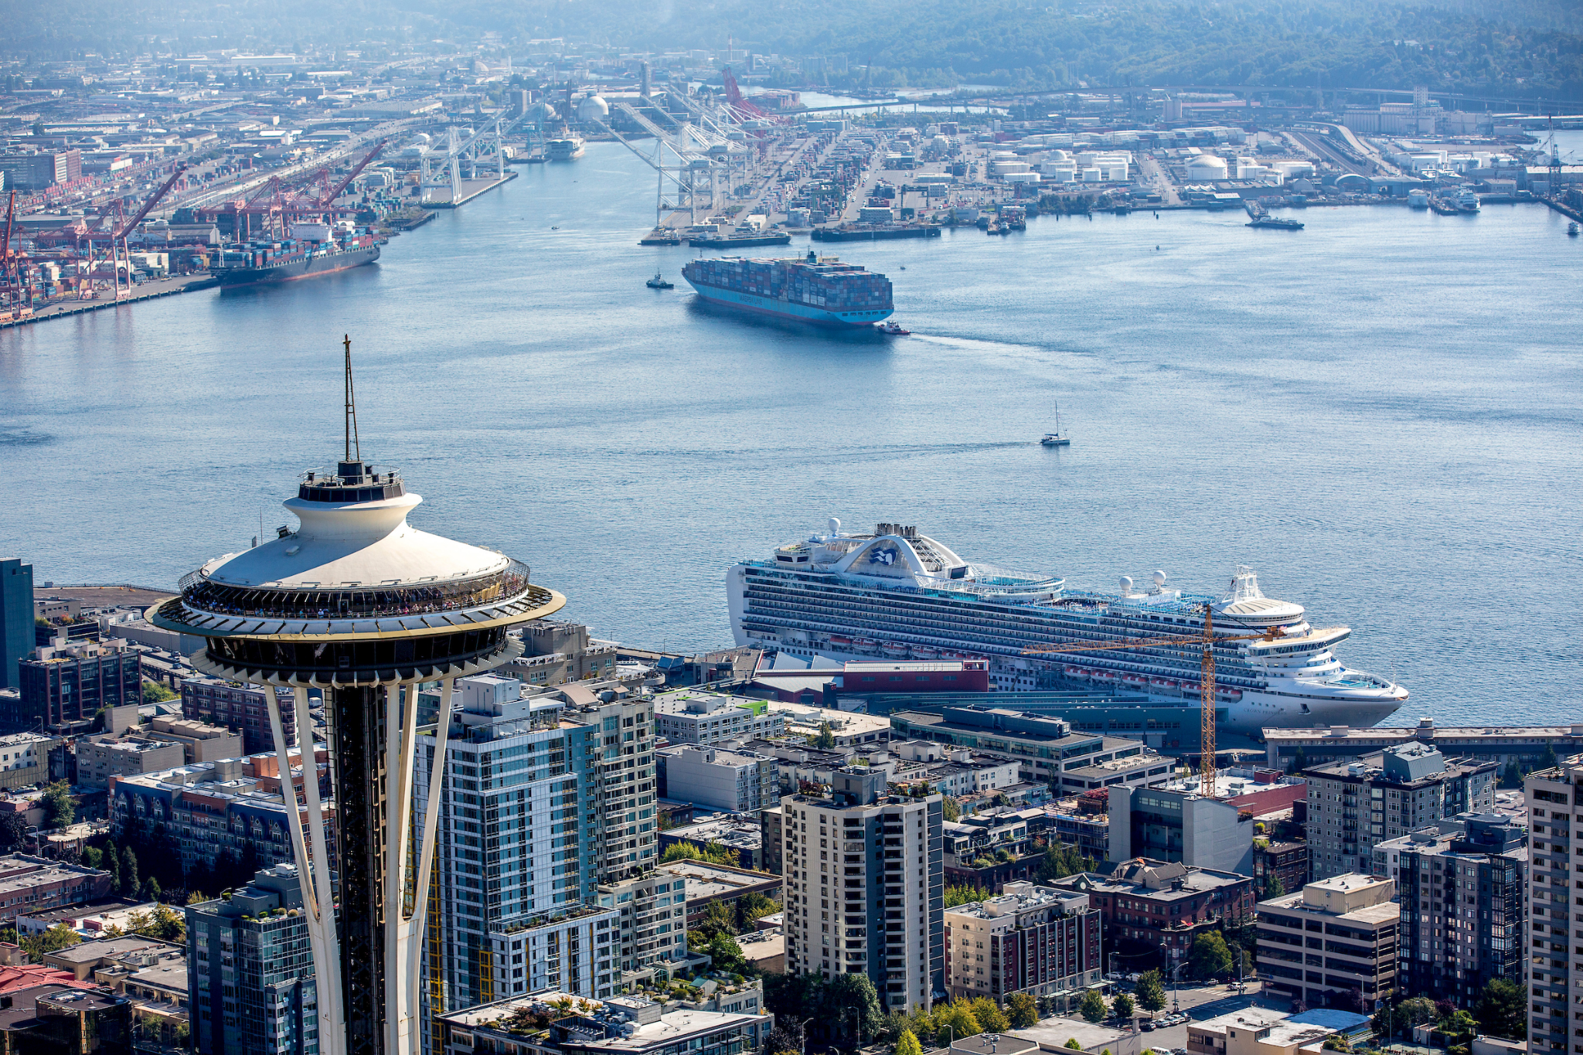
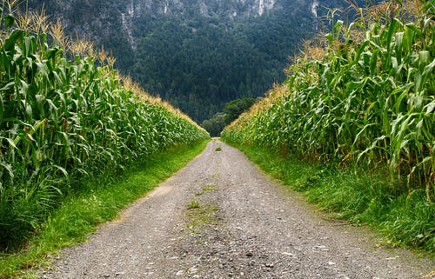
Machine Learning - Will it Rain?
Machine Learning is a subset of AI
ML - Make a program that can take processed inputs and make a strong prediction WITHOUT us coding anything about the data
Q: what would an ML solution to this problem look like?

Slide 4

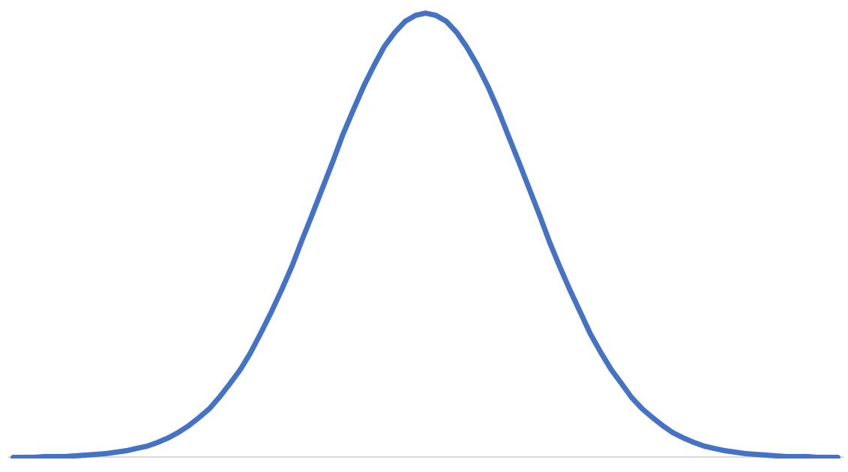
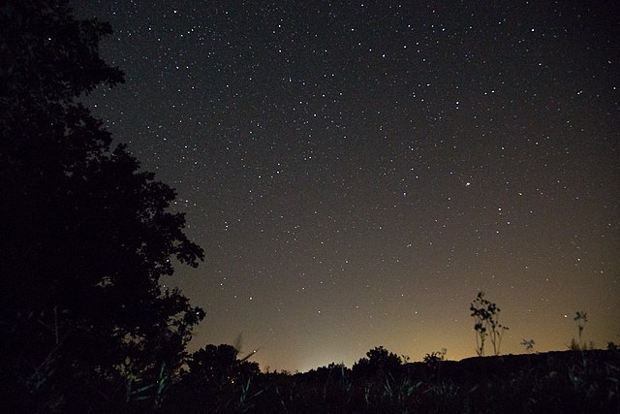

Raw Data => Inputs => Model => Outputs
Raw Inputs: Sky Color, whether it rained
Encoding: Convert to Numerical scale (0, 255)
Create Regression: Bell graph (with code)
Predict!
Grey
White
Black

Slide 5
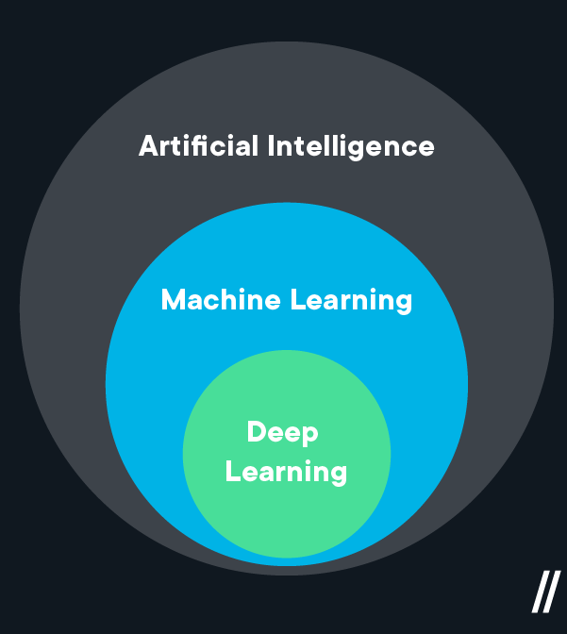
Deep Learning - Will it Rain?
Deep Learning is a subset of Machine Learning
Loosely modeled on human brain
ML is good for smaller amounts of data, less monetary resources
Deep learning is good for massive data and more expensive
For Later: What would a Deep Learning Approach look like for this problem?

Slide 6
Q: Machine Learning Use Cases?
IoT
Thermostat
Lightbulbs
Vacuum
etc.
Online Retail
Advertisements
Product Recommendations
Web Searches
Typing
Search Results
Natural Language Processing
Social Media
Computer Vision
Facial Recognition
Image Generation
Driving
Medicine
Finance
Bonds!
For more search “machine learning AI use cases” on google!

Slide 7
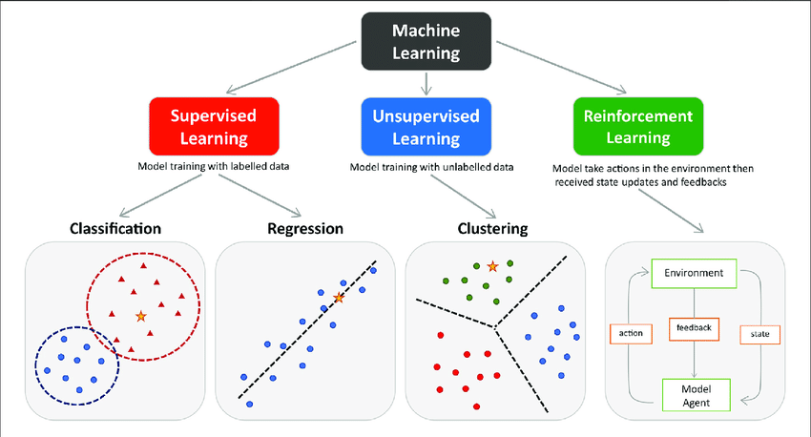
Model Types
Preprocessing
Types of Machine Learning
Supervised Learning
Use: Prediction of a single value
Ex: Classify images, predict bonds!
Unsupervised Learning
Use: Data Exploration,
Ex: Customer Recommendations, Classification
Reinforcement Learning
Use: Self Learning with live inputs
Ex: Self Driving Car

Slide 8
Supervised Learning
Most general form of machine learning
Learning is “Supervised” when training…
Create Model Structure
Load/Process Data
Input Columns and “Correct” Output Column
Rows represent a new entry
Plug a row of the data into the model
Get a result and compare it to the “Correct” value
Model will adjust (depends on type of model)
Repeat for rest of data/training process
Notes:
Supervised Concept

Slide 9
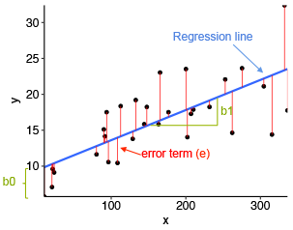
Ex: Supervised Learning
Linear Regression
General idea is to minimize absolute distance from data to a line best fit
Given an input, the linear regression model can predict an output
This graph displays 1D input
Can work with N dimensions (harder to visualize though)
We can use this to predict bond prices!
Notes:
Supervised practice

Slide 10
Unsupervised Learning
Less common form of machine learning
Learning is “Unsupervised” when training…
Create Model Structure
Load/Process Past Data
Only Input columns
Each row is a single entry of data
Pick number of “clusters” to find in the data
Assign preliminary guesses for “cluster” centroids
Find new “cluster” centroids
Repeat above step until converges (or run out of resources)
Notes:
Unsupervised concept

Slide 11
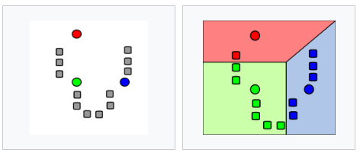
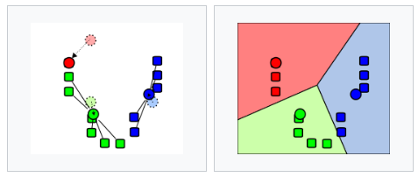
Ex: Unsupervised Learning
K-Means Model:
Assign k random centroids
Partition data based off of closest centroid
Move centroid to mean of partitioned data
Throw out partitions, repeat step 2-3
Notes:
Unsupervised practice

Slide 12
Reinforcement Learning
Moderately common form of machine learning
Learning is “Reinforced” when training…
Create Model Structure
Start model
Give model inputs
Model makes decision
Decision produces results (some degree of favorable or unfavorable, as well as new inputs)
Use inputs to continue from step c
Notes:
Reinforcement concept

Slide 13
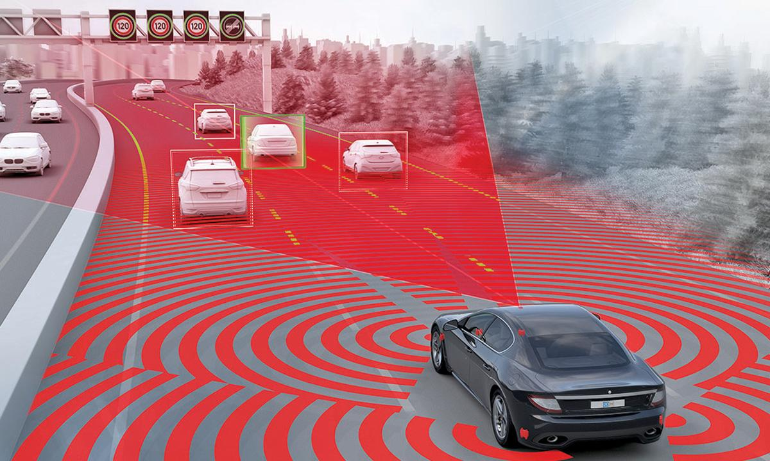
Ex: Reinforcement Learning
Self Driving Car
Car is constantly receiving input from sensors
Input processed and fed into model, produces steering instructions
Instructions are executed
New inputs are generated and fed into model again
Notes:
Reinforcement practice

Slide 14
Helpful Resources for Concepts (ML)
Free:
Google: https://developers.google.com/machine-learning/crash-course/ml-intro
Udacity: https://www.udacity.com/course/intro-to-machine-learning--ud120
Stanford: https://www.coursera.org/learn/machine-learning
MIT: https://openlearninglibrary.mit.edu/courses/course-v1:MITx+6.036+1T2019/about
Notes:
Resources to learn the concept. Google is good since they are developers of tensorflow (which is used for deep learning in industry)

Slide 15
Data Preprocessing
To train strong models (and remove bias), we want…
Varied Data
Common issues: Lack of data, skewed data
Fix: Get better data, impute values
Numerical inputs
Common issues: Categorical fields, null values
Fix: Impute values, encode values
Lots and lots of data
Common issues: Lack of data, null values
Fix: Get more data, impute values
Techniques: https://towardsdatascience.com/introduction-to-data-preprocessing-in-machine-learning-a9fa83a5dc9d
Ex: https://medium.com/@yogeshojha/data-preprocessing-75485c7188c4
Notes:
Before we can make any model, we need to preprocess. See the common problems and fixes. The colab notebook shows these in action, the medium article summarizes them in a general scenario.

Slide 16
Model Creation
Types of models
Decision Trees and Random Forest (and Boosted Trees)
SVM (Support Vector Machines)
Naive Bayes
Regression Models
Great walkthrough: https://towardsdatascience.com/a-beginners-guide-to-text-classification-with-scikit-learn-632357e16f3a#660b
SciKit Learn offers many model types out of the box: https://scikit-learn.org/stable/modules/classes.html
.fit() trains the model (with training and evaluation data as parameters)
.predict() predicts results (with testing data as parameters)
Notes:
Now that we have data, let’s make a model. Let’s look at this beginner guide. Sklearn has many models and parameters, which you can see in SciKit learn API.

Slide 17
Tips to Experiment
Familiarize yourself broadly with Python
Numpy and Pandas are great for preprocessing data
Ex: https://colab.research.google.com/drive/1YVX7VLx4JdDj5KWwzz6RGRVHSYapNKRC?usp=sharing
(Most datasets were stored in the bond_model_storage/Datasets bucket under cloud storage)
Scikit learn is great for ML models
Ex: Unsupervised - https://colab.research.google.com/drive/1sUlu7hY3NvEoiuNQmTLIUUpx99Pow2hc?usp=sharing
Ex: Supervised (Regression) - https://scikit-learn.org/stable/auto_examples/linear_model/plot_ols.html
Notes:
General tips for learning and practicing

Slide 18
Best way to learn: Hands On!
Try constructing some of the regression models found here: https://towardsdatascience.com/machine-learning-basics-simple-linear-regression-bc83c01baa07
Try constructing some of the classification models found here: https://towardsdatascience.com/a-beginners-guide-to-text-classification-with-scikit-learn-632357e16f3a#660b
Try constructing some unsupervised learning models found here: https://machinelearningmastery.com/clustering-algorithms-with-python/
Notes:
Starters for different types of models and preprocessing

Slide 19
Looking Forward: Machine Learning Models
Nearest Neighbor
Naive Bayes
Decision Trees
Linear Regression
Support Vector Machines (SVM)
From: https://towardsdatascience.com/types-of-machine-learning-algorithms-you-should-know-953a08248861

Slide 20
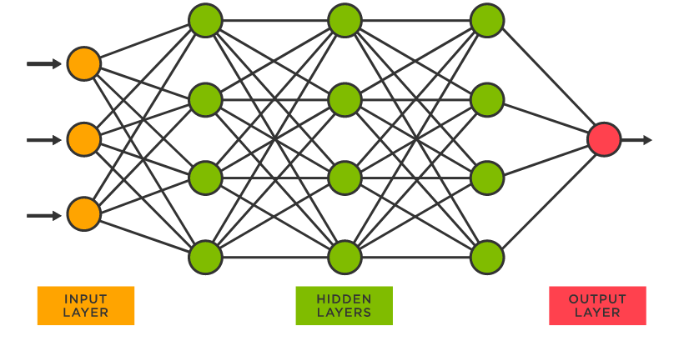
Looking Forward: Neural Networks
The future of AI: Deep Learning (made possible by neural networks)
Notes:
Neural Networks: for next time

